Slide 1

created by Marco, Harald, Rene, Phillip and Leonie

Slide 2

Table of contents
Story
Levels and Rooms
Game Mechanics
Gameplay
Website

Slide 3
Table of contents
Story
Levels and Rooms
Game Mechanics
Gameplay
Website

Slide 4
Table of contents
Story
Levels and Rooms
Game Mechanics
Gameplay
Website

Slide 5
Table of contents
Story
Levels and Rooms
Game Mechanics
Gameplay
Website

Slide 6
Table of contents
Story
Levels and Rooms
Game Mechanics
Gameplay
Website

Slide 7
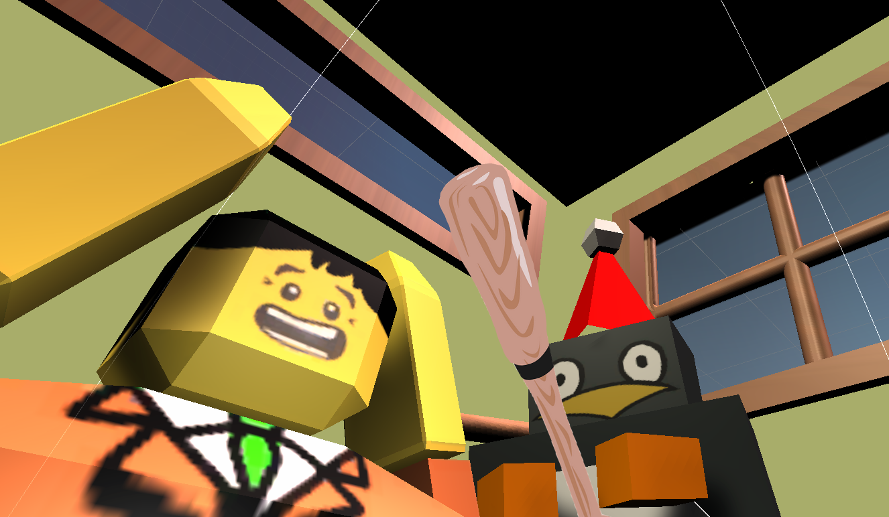

Slide 8
Olaf

Slide 9
Brian

Slide 10
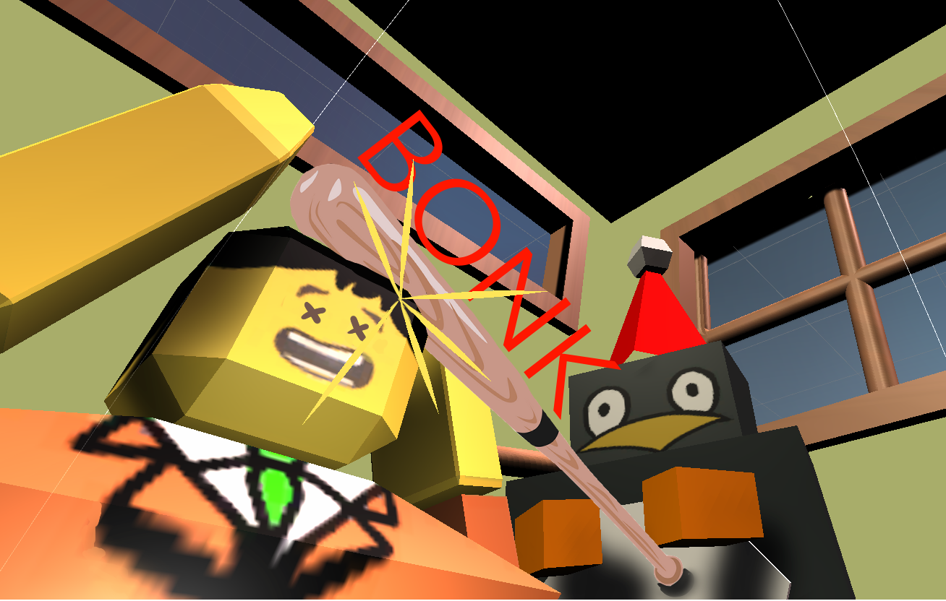

Slide 11
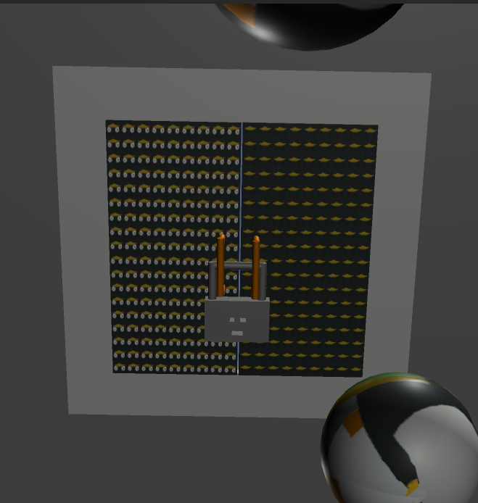
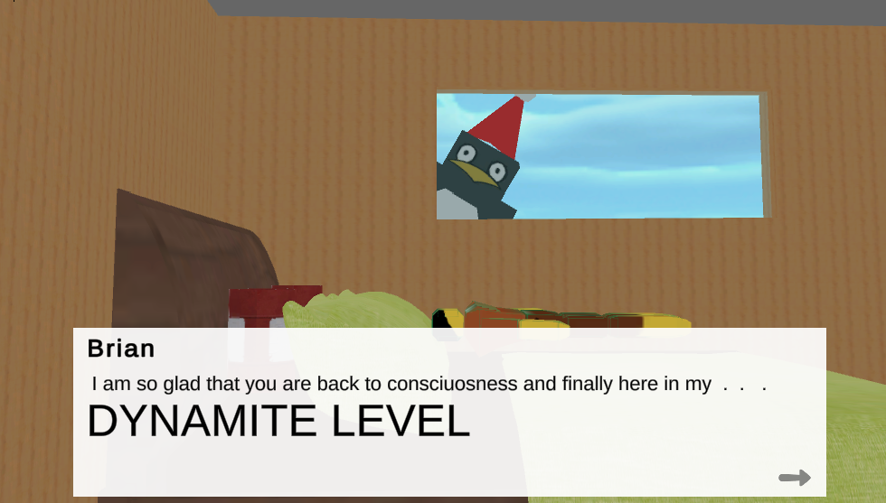
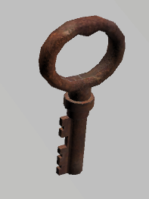
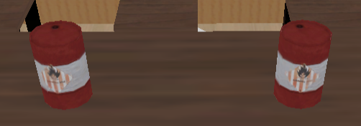
Player control

Slide 12


Gravity control

Slide 13
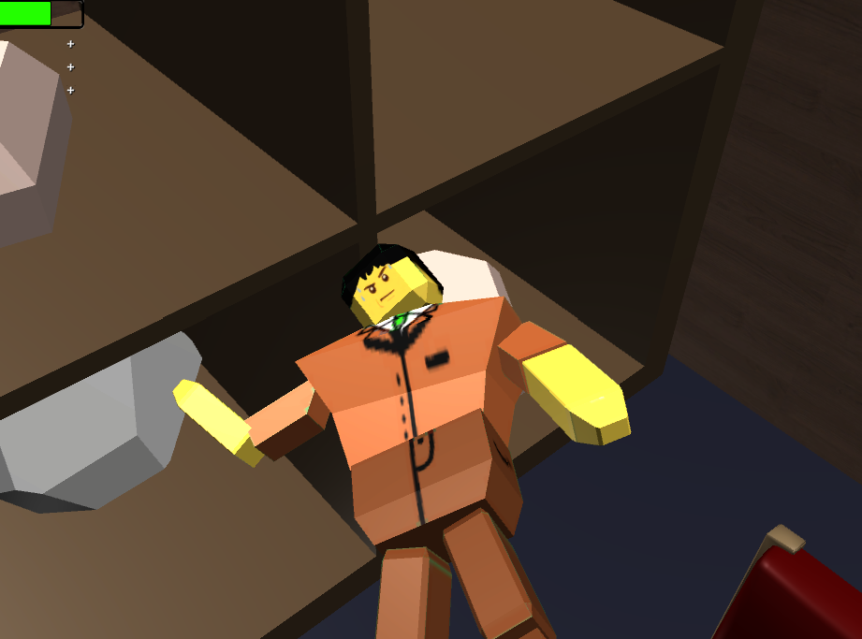
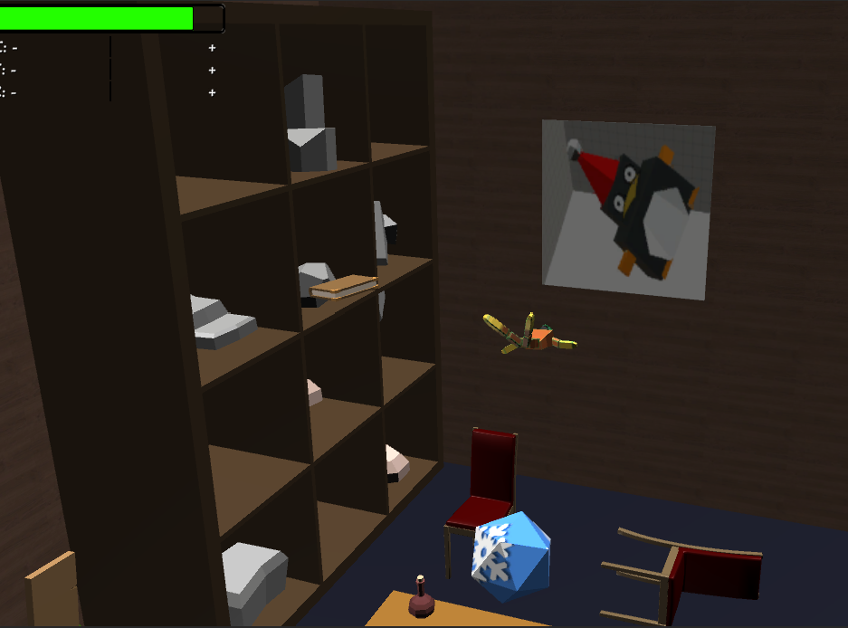
Camera Control

Slide 14
Damage System

Slide 15
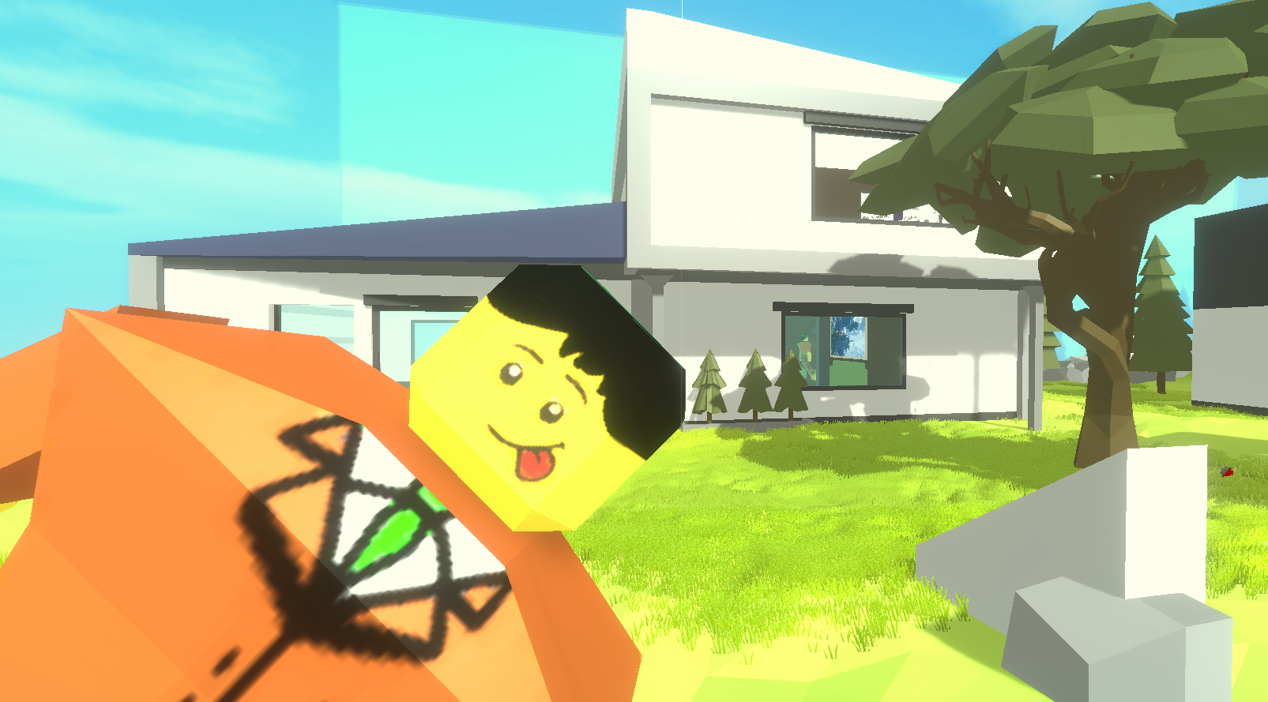
Gameplay

Slide 16
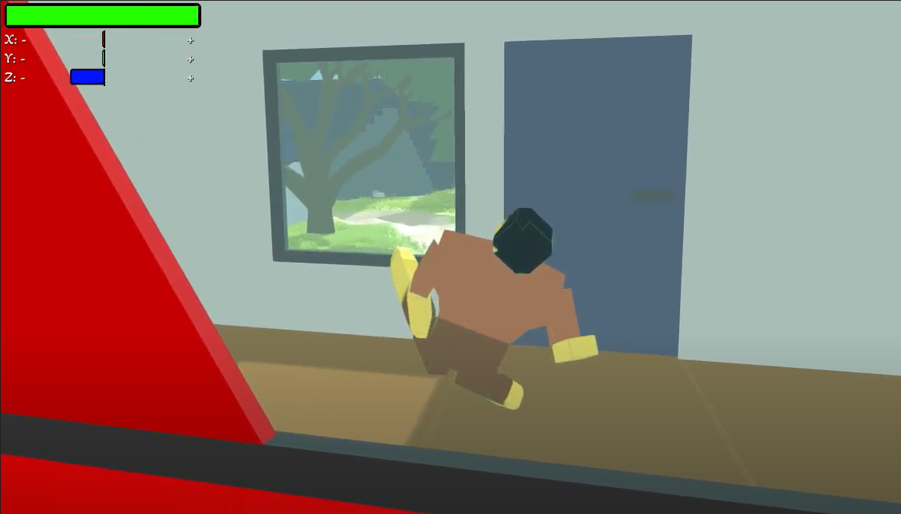

Slide 17
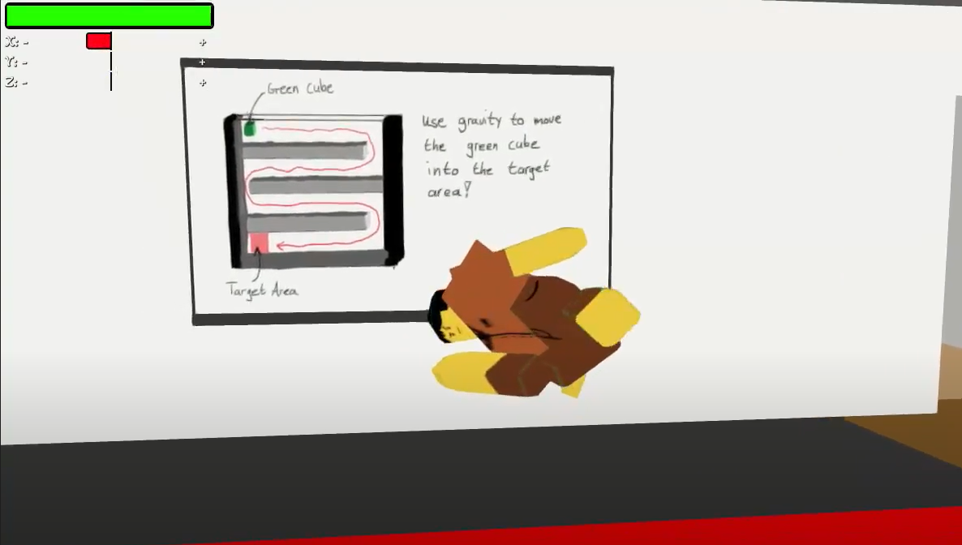

Slide 18
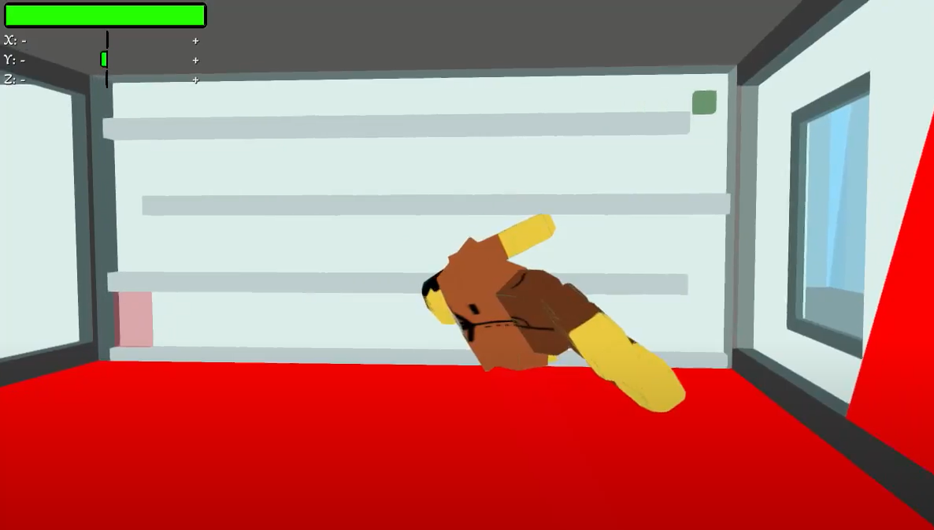

Slide 19
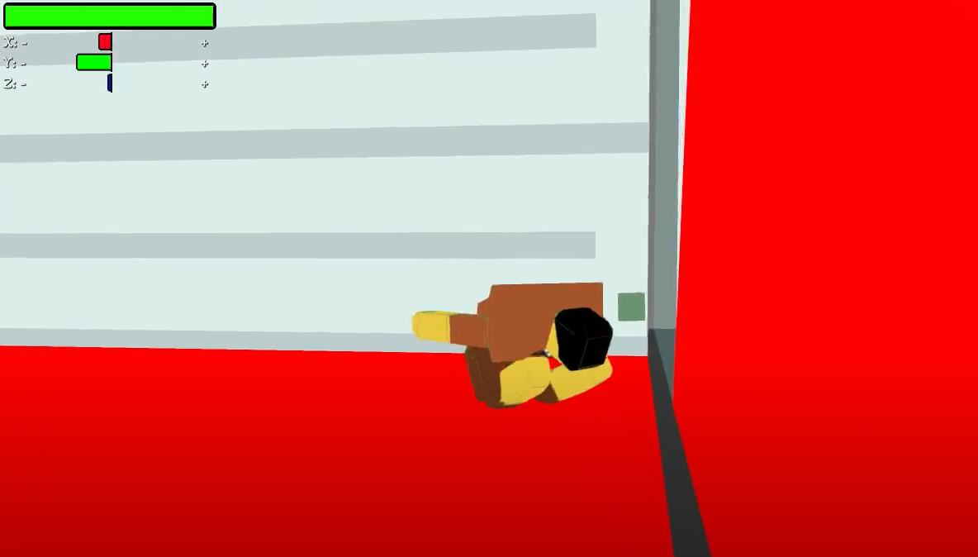

Slide 20
